Slide 1
Remote Control for CPG-based robot
Laura Balthazard

Slide 2
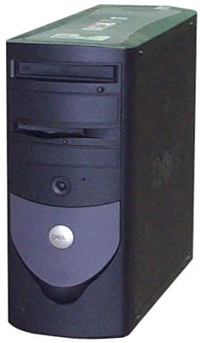
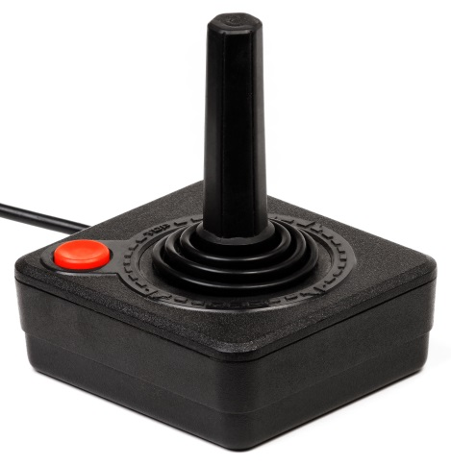
Ways to control the robots
At the beginning
Joystick + radio interface + computer
Notes:
Five years ago, a student made a remote which allows to not use a computer anymore to control the robots.
This remote is wireless and the antenna to communicate with the robots is integrated to the remote itself and not connected to the computer through a usb port like before.
This remote works and is used but can still be improved. is the lack of functionalities. We still need a computer if we want to change the firmware of the robots. And it’s not handy to control the robot with one hand.

Slide 3
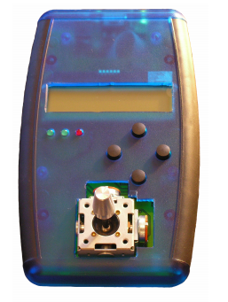
Ways to control the robots
First remote model
Autonomous remote: wireless
Radio interface integrated
No need of a computer
But :
Not ergonomic
Limited in functionality

Slide 4
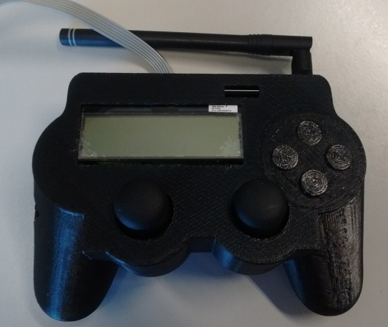
Ways to control the robots
Second model :
ZigBee communication
More ergonomic
SD card
But :
Nothing is finished

Slide 5
Objective
Continue the development of the wireless remote control

Slide 6
Improvements needed
Software part
Control of the Amphibot
Make everything work

Slide 7
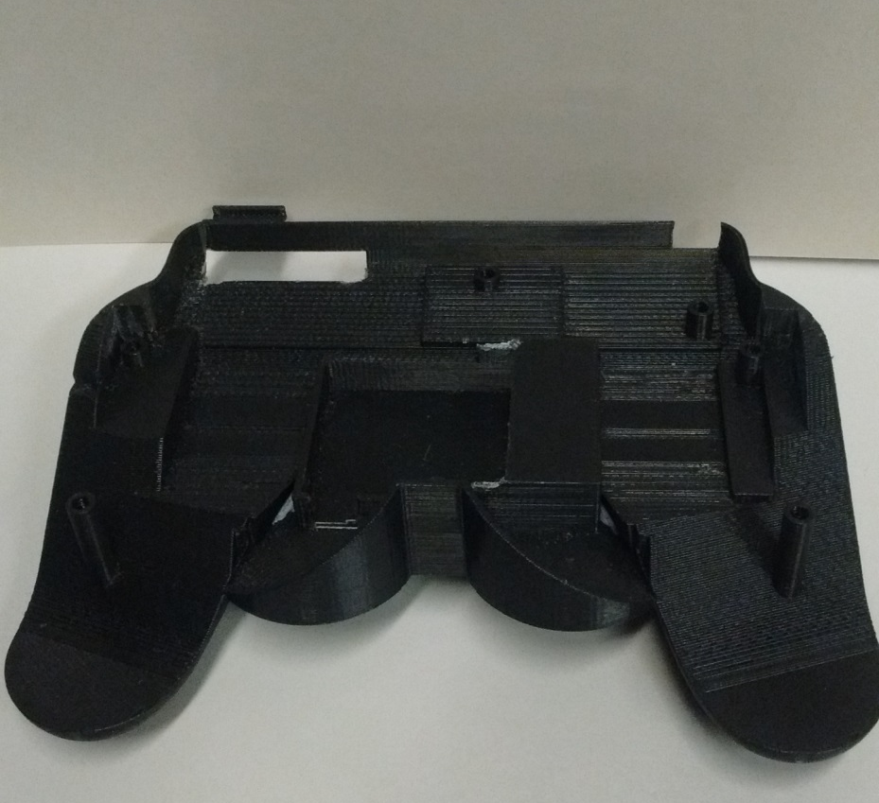
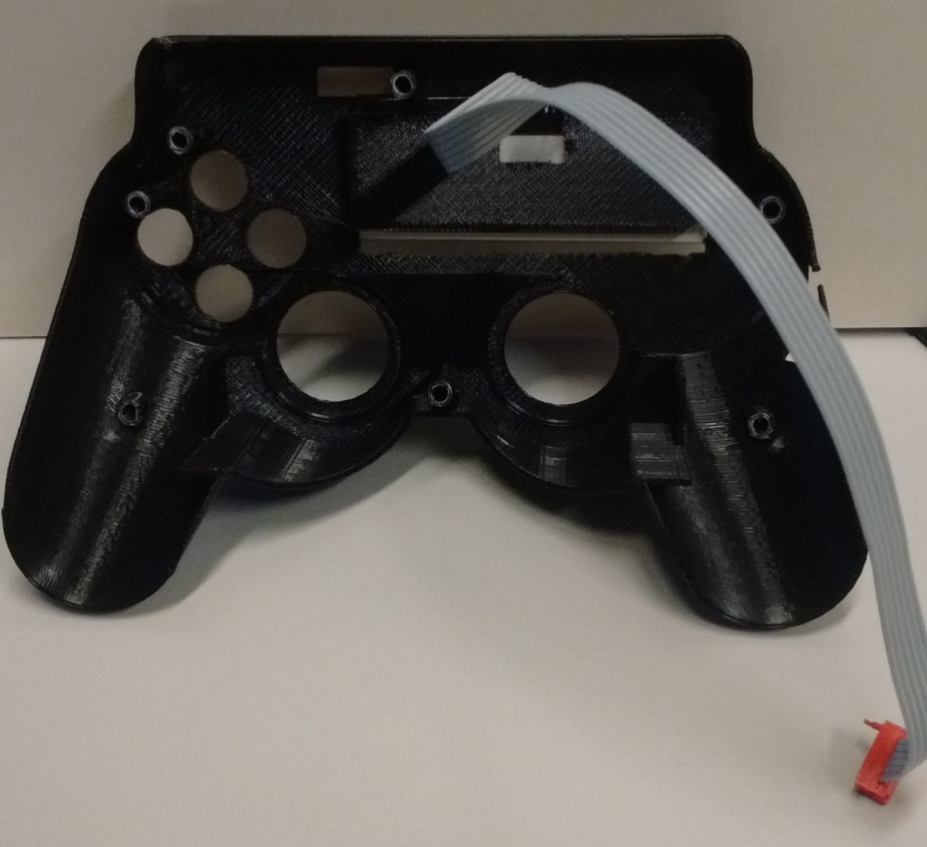
Improvements needed
Mechanical part

Slide 8
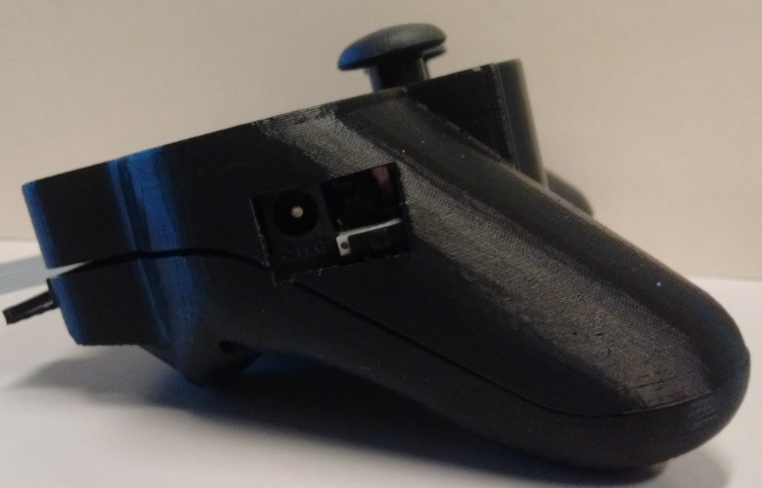
Improvements needed
Mechanical part
Notes:
Finally there are two holes where Matthieu took the dimensions from the board but he didn’t think of the dimensions of the cables to plug in. So it doesn't fit. Like for the battery.
Hole to recharge the battery
Hole for the antenna
Buttons

Slide 9
Improvements needed
Mechanical part

Slide 10
What I have done
Software part
Studying of the code
Understanding of Chibios/RT
Getting started with the board: blinking of the LED
Mechanical part
Resizing of the holes

Slide 11
Thanks for your attention
Do you have any questions ?

